Slide 1
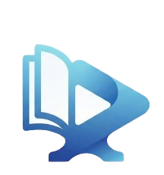
01
04
02
03
06
05
Media
Forge
Context and Problem Statement
Objectives
Analysis and Requirements
Technical Solution and Architecture
Conclusion and Perspectives
Demonstration
Presented by :
Nizar El Idrysy - Nizar Btira - Hajar Chabli
Supervised by :
Youssef Jdidou

Slide 2
01
02
03
04
05
06
Context and Problem Statement
Objectives
Analysis and Requirements
Technical Solution and Architecture
Demonstration
Conclusion and Perspectives
01

Slide 3
Objectives
-Develop "MediaForge," a C++ application to -automate library management.
-Handle loans and returns instantly.
-Create an OOP hierarchy for all media types.
-Ensure permanent storage using text files.
-Generate reports and audiovisual statistics
03
04
01
02
Context and Problem Statement
-Develop "MediaForge," a C++ application to -automate library management.
-Handle loans and returns instantly.
-Create an OOP hierarchy for all media types.
-Ensure permanent storage using text files.
-Generate reports and audiovisual statistics
02

Slide 4
Analysis and Requirements
-Content management
-The user experience
-The transactional logic
03
04
01
02
Objectives
-Develop "MediaForge," a C++ application to -automate library management.
-Handle loans and returns instantly.
-Create an OOP hierarchy for all media types.
-Ensure permanent storage using text files.
-Generate reports and audiovisual statistics
03
Context and Problem Statement
-Develop "MediaForge," a C++ application to -automate library management.
-Handle loans and returns instantly.
-Create an OOP hierarchy for all media types.
-Ensure permanent storage using text files.
-Generate reports and audiovisual statistics

Slide 5
Technical Solution and Architecture
-Due to console limitations, media playback is handled through external applications to ensure a smooth user experience
-The interface uses ANSI escape codes and cursor control to render a dynamic, colored terminal UI from a single managed screen state
03
04
01
02
Analysis and Requirements
-Content management
-The user experience
-The transactional logic
04
Objectives
-Develop "MediaForge," a C++ application to -automate library management.
-Handle loans and returns instantly.
-Create an OOP hierarchy for all media types.
-Ensure permanent storage using text files.
-Generate reports and audiovisual statistics

Slide 6
03
03
04
04
05
01
06
02
Technical Solution and Architecture
-Due to console limitations, media playback is handled through external applications to ensure a smooth user experience
-The interface uses ANSI escape codes and cursor control to render a dynamic, colored terminal UI from a single managed screen state
05
Analysis and Requirements
-Content management
-The user experience
-The transactional logic

Slide 7
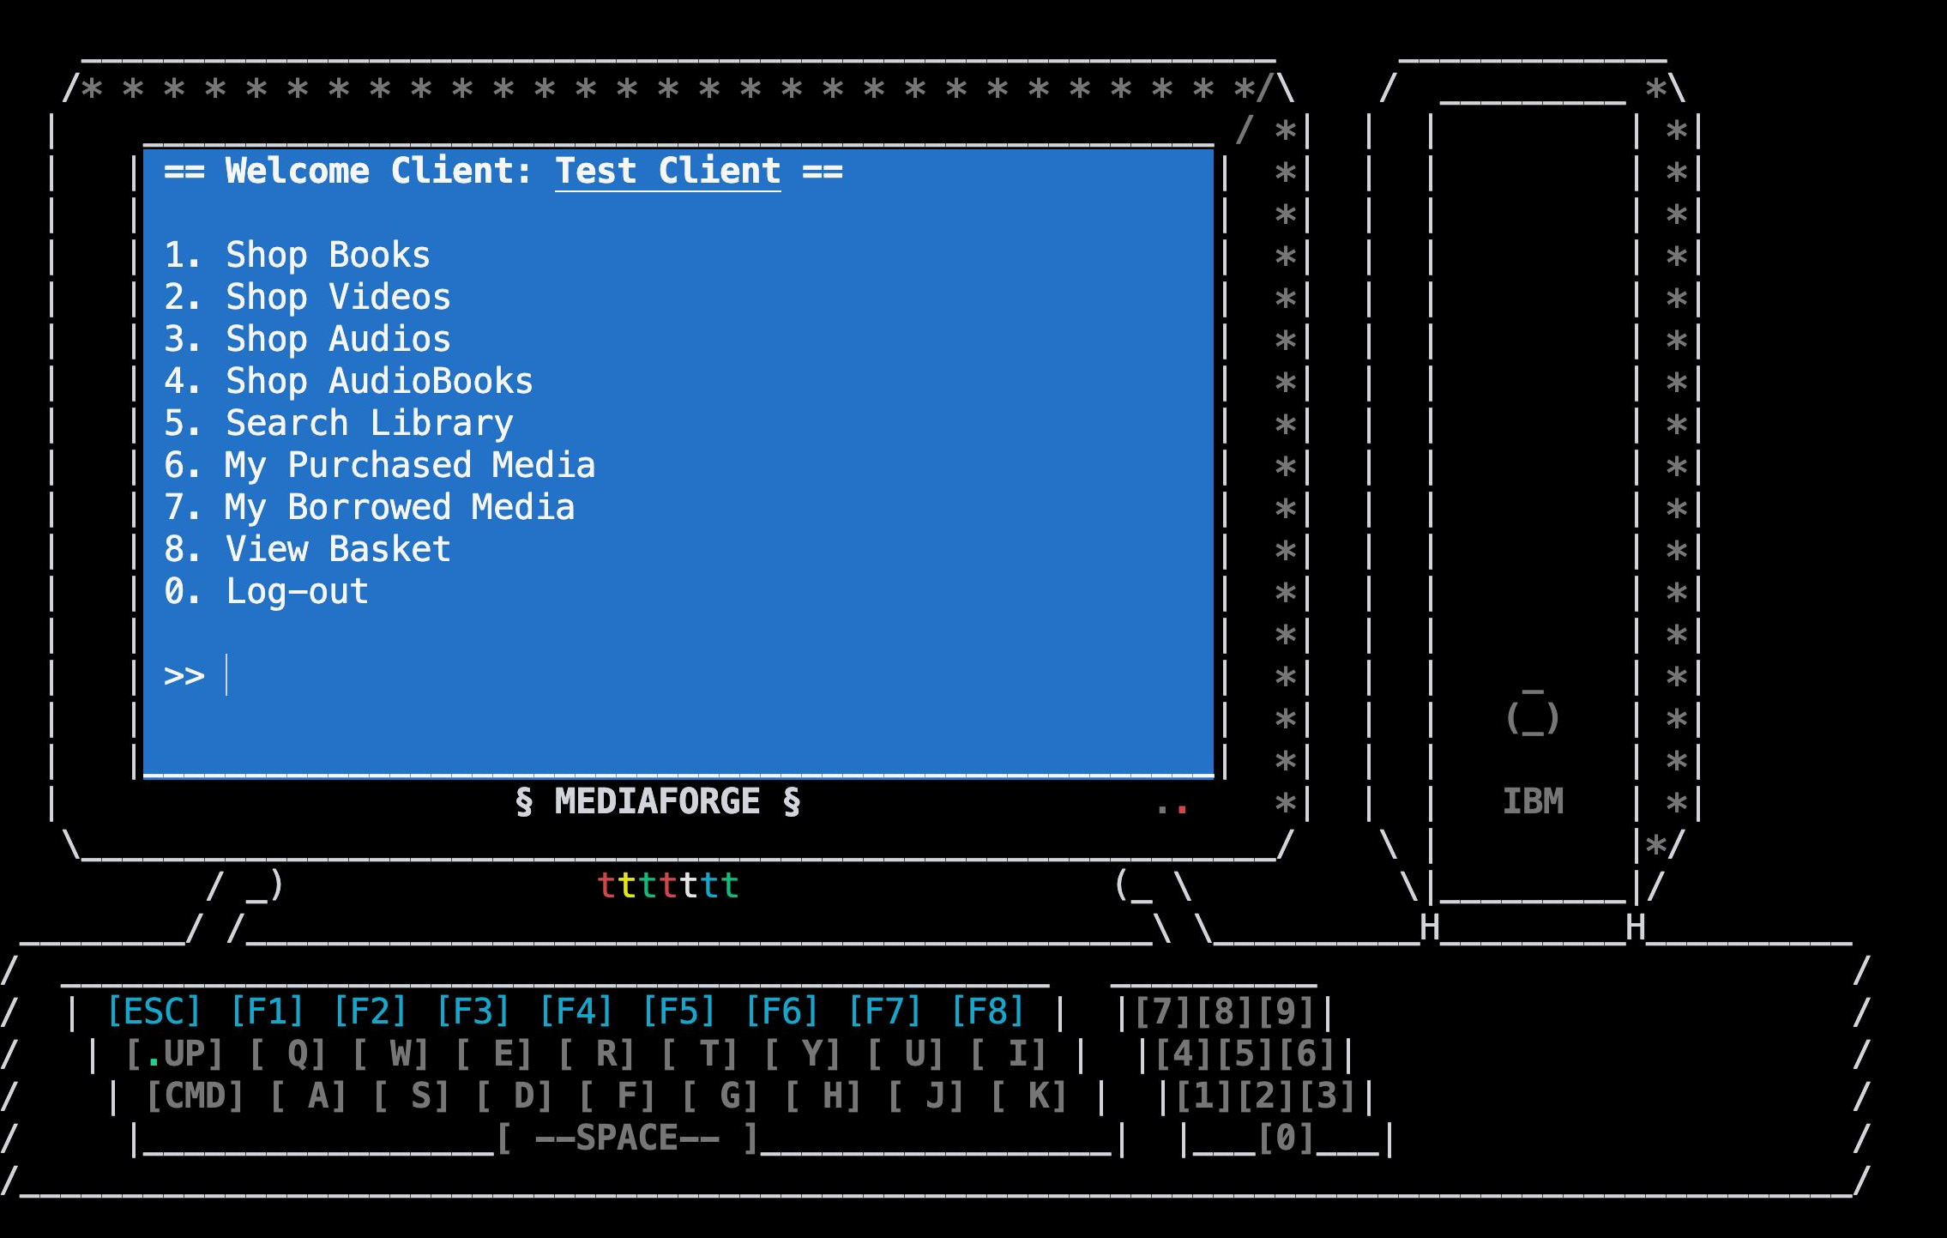
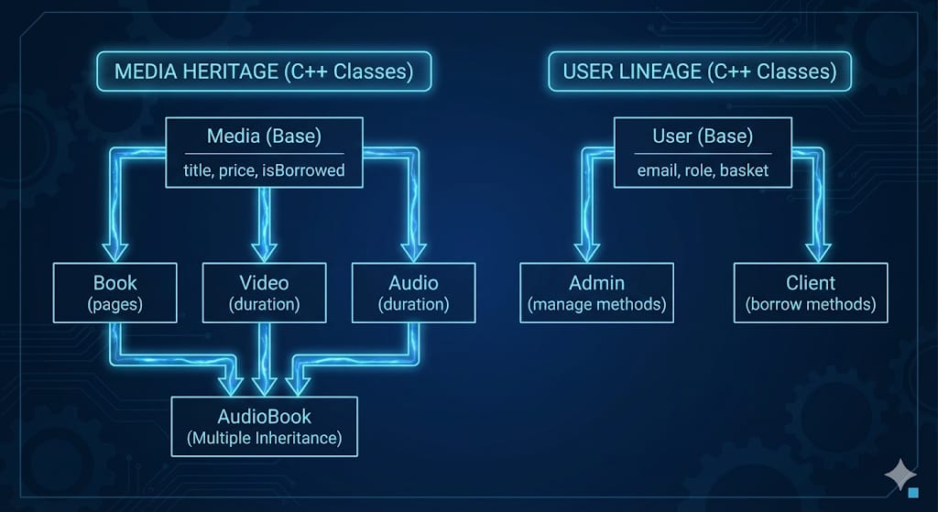
Demonstration
-Testing phase
03
03
04
04
05
01
06
02
Technical Solution and Architecture
06

Slide 8

Conclusion and Perspectives
03
04
05
06
Demonstration
-Testing phase
07
Solution proposée et architecture

Slide 9
03
04
05
06
Conclusion and Perspectives
08
Demonstration
-Testing phase

Slide 10
Conclusion and Perspectives
03
04
05
06
Thank You
Nizar BTIRA
Nizar EL IDRYSY
Hajar CHABLI
Supervised by :
Youssef Jdido
Solution proposée et architecture

Slide 11
01
04
02
03
06
05
Media
Forge
Context and Problem Statement
Objectives
Analysis and Requirements
Technical Solution and Architecture
Conclusion and Perspectives
Demonstration
Presented by :
Nizar El Idrysy - Nizar Btira - Hajar Chabli
Supervised by :
Youssef Jdidou

